Slide 1
MEDICAL MATCHER
DMEMATCHER.COM – Process Flow / Features

Slide 2
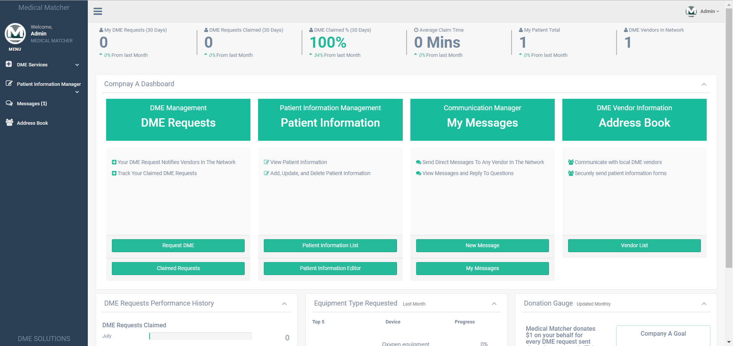
Home Health Dashboard

Slide 3
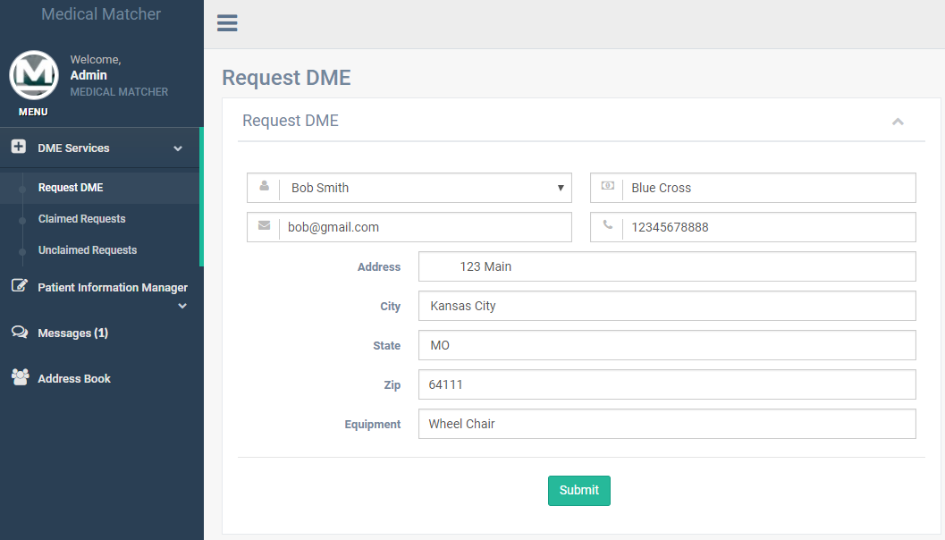
1. Request Equipment
Home health companies can select a patient from their database which auto populate the request form to send out to our network of DME companies.

Slide 4
2. Equipment request is claimed
DME companies are notified of new requests via email. They can then login to their dashboard to view/claim requests (map is being updated).

Slide 5
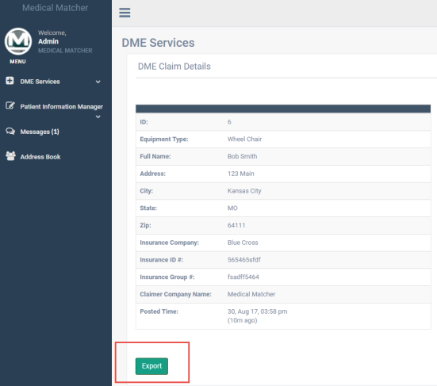
3. Stream Lining Communication
Home health is notified once the request has been claimed. Home health can login to their dashboard and view the claim details like which DME company claimed the request for example.
Additionally, a pdf with pertinent patient information can be automatically generated to be sent to the DME company that will be needed to complete the request.

Slide 6
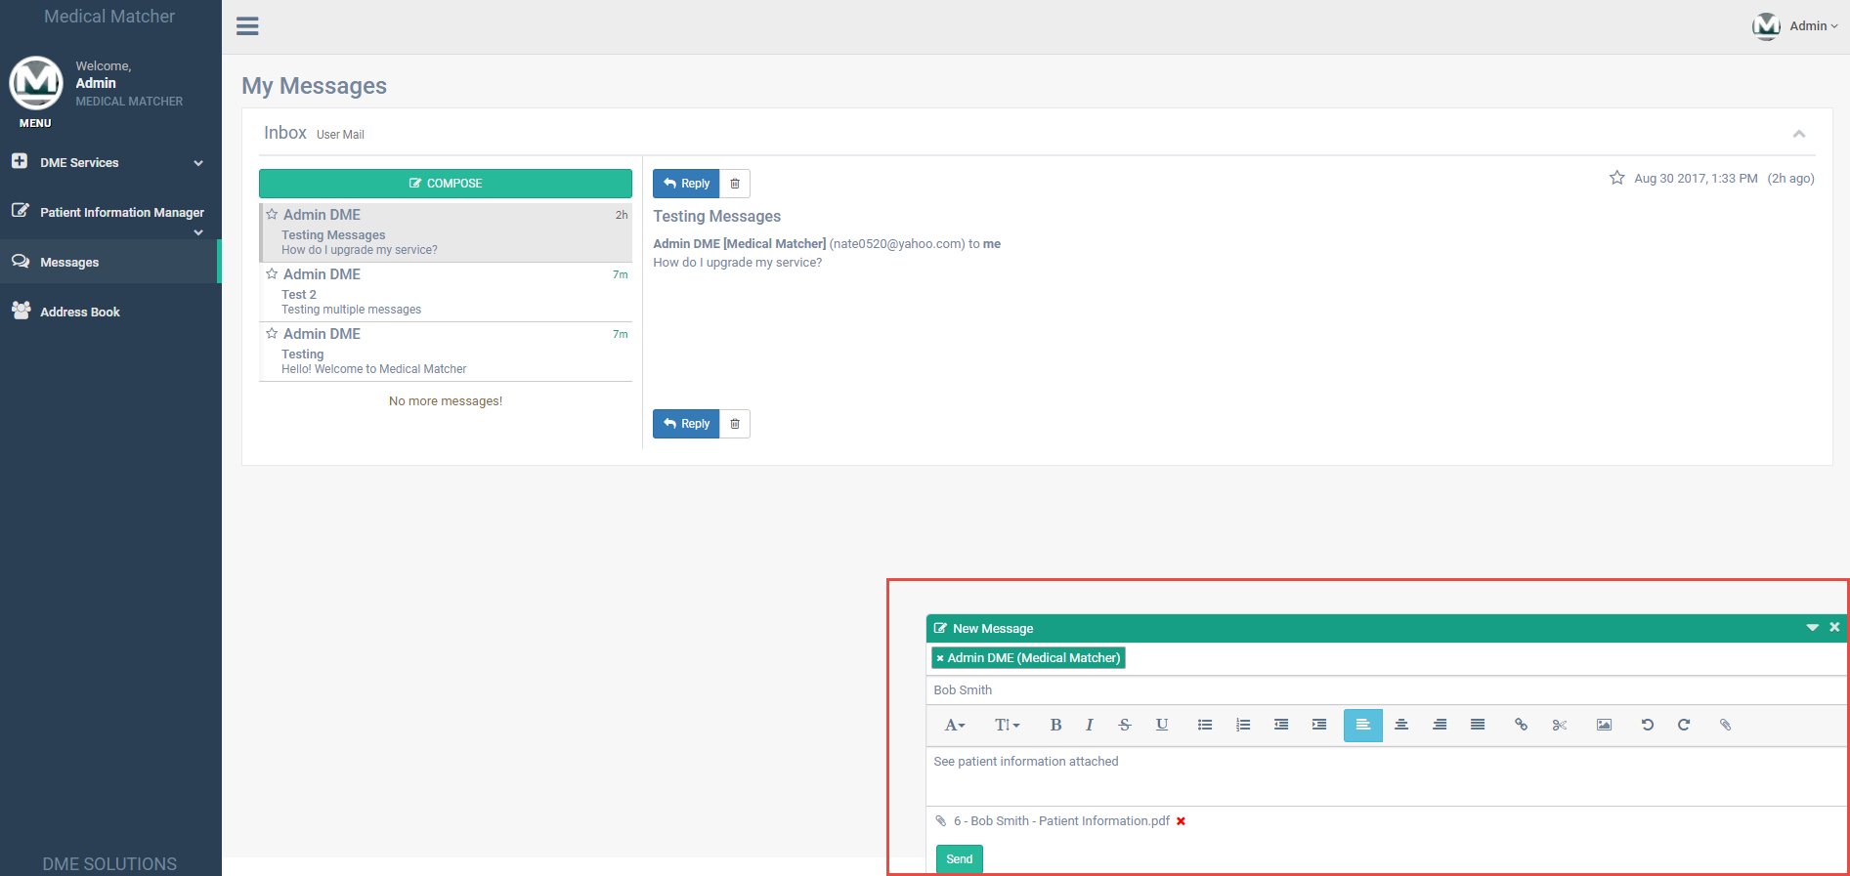
3. Internal Messaging Platform
Home health can send the exported pdf directly to the DME company through our internal messaging platform.

Slide 7
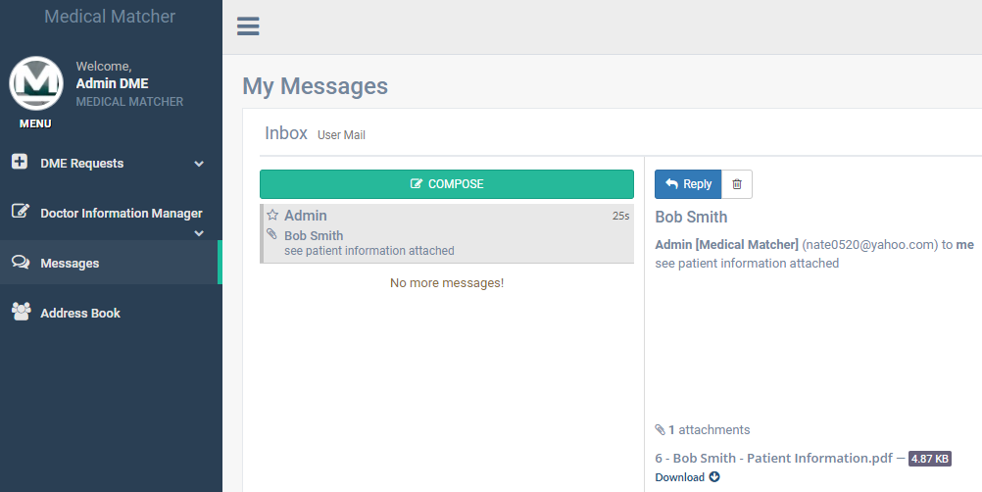
3. Internal Messaging Platform
DME company quickly receives patient information they need to complete the request.

Slide 8
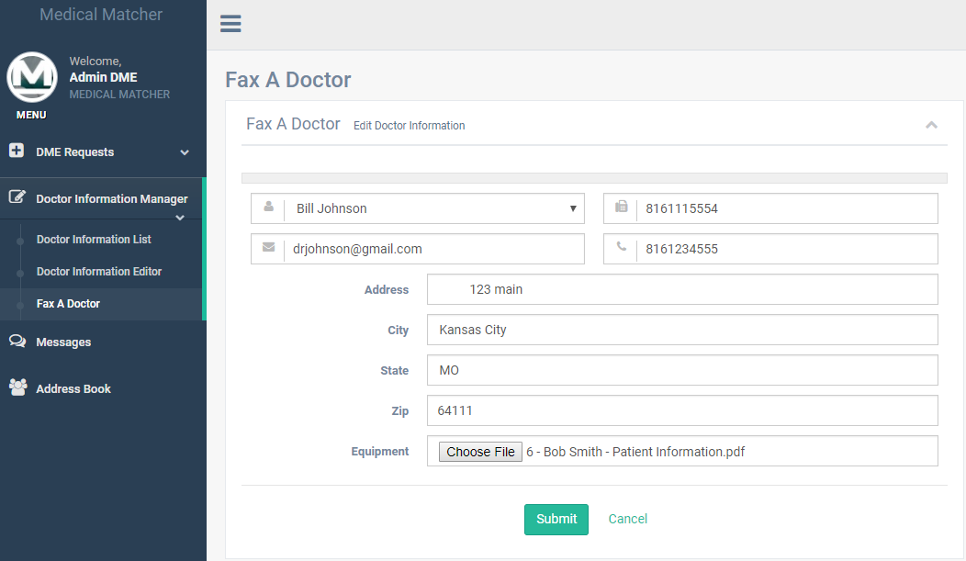
3. Internal Messaging Platform
DME can take patient information and fax it online directly to the necessary doctor.

Slide 9
4. Process Complete
DME company can fill the equipment request and mark the request as complete which will also notify the home health company that the equipment is on the way.

Slide 10
5. Additional Features
Additional Features Included:
Performance Tracking
Performance Trends
Market Trends
Patient/Doctor Information Management
Address Book
Equipment Request Search Filter

